Slide 1
Controlling the Page Navigation
(Section 2)

Slide 2
The properties of a bounded task flow
Initializer
Finalizer
Save Point Restore Finalizer
URL Invoke
url-invoke-allowed
url-invoke-disallowed
calculated
Library Internal
Parameters
Return Value
Train
Task Flow Reentry
reentry-allowed
reentry-not-allowed
reentry-outcome-dependent
Critical
generate implicit save points on entry to all task flows that are marked as critical.
The framework will keep track of uncommitted data changes for critical task flow and warn the user if the person tries to exit from the task flow without committing changes.

Slide 3
The properties of a bounded task flow
Transaction
No Controller Transaction : The bounded task flow neither participates in existing transactions nor starts a new transaction.
Always Use Existing Transaction : . If no existing transaction is found in progress, then an exception is thrown
Use Existing Transaction If Possible
Always Begin New Transaction
Share Data Control with Calling Task Flow
No Save Point on Task Flow Entry : optionally prevent the creation of an ADF model save point on task flow entry

Slide 4
Calling a bounded task flow using the task flow call activity
a bounded (or unbounded task flow) built with complete JSF pages can only call another task flow built with complete JSF pages. Similarly, a bounded task flow built with page fragments can use a task flow call activity to call another bounded task flow built with page fragments.
Drag-and-drop a task flow call activity from the ADF Task Flow component palette onto the task flow diagram.
<document>/WEB-INF/dynamic/emp-detail-task-flow-definition.xml</document>
<id>emp-detail-task-flow-definition</id>
drag-and-drop an existing task flow from the Application Navigator tab on to the task flow diagram.

Slide 5

Using dynamic task flow calls
private final String EMP_SUMMARY_TF =
"/WEB-INF/dynamic/emp-summary-task-flow-definition.xml#empsummary-task-flow-definition";
private final String EMP_DETAIL_TF =
"/WEB-INF/dynamic/emp-detail-task-flow-definition.xml#empdetail-task-flow-definition";
public TaskFlowId getDynamicTaskFlowId() { if("summary".equals(AdfFacesContext.getCurrentInstance().
getPageFlowScope().get("EmpViewHint"))) {
return TaskFlowId.parse(EMP_SUMMARY_TF);
} else {
return TaskFlowId.parse(EMP_DETAIL_TF);
}
}

Slide 6
Commonly used properties for a task flow call activity
Parameters and Return Values
before-listener
Run As Dialog

Slide 7
Using remote task flow calls
To invoke a remote task flow select the task flow call activity in the diagram, and then in the Property Inspector window, specify Remote Application URL pointing to the task flow in a remote web application.
open the task flow in the diagram editor and in the Property Inspector window select url-invoke-allowed. The default is calculated which will allow the URL to be invoked if the task flow has a view activity as the default activity and does not have any initializer routine.
The URL syntax for calling a bounded task flow is as follows:
http://127.0.0.1:7101/MyTestApp/faces/adf.task-flow?adf. tfId=employee-task-flow-definition&adf.tfDoc=/WEB-INF/taskflowreturn/ employee-task-flow-definition.xml&departmentId=10&locationId=1700

Slide 8
What you may need to know when you use remote task flow
When an application invokes remote task flow, the framework exits the current task flow and transfers the control to the remote task flow seamlessly.
Geometry management for the UI
Memory scoped variables
Interaction Patterns
Run As Dialog option (ADF 11.1.2.2.0 )
Transaction Support and Sharing Data Control
Security

Slide 9
Parameterizing a bounded task flow
Using Input Parameters list
Using Input Parameters Map : parameter values will be specified using an EL expression that evaluates to a java.util.Map

Slide 10
Defining the task flow return value Reading a return value from a task flow
Reading returned values when a called task flow is run as a page
Reading returned values when called task flow is run as dialog:
To read a returned value from a custom return listener method, specify the Dialog Return Value. Note that this value should match with the return value defined for the called task flow.
set useWindow = "true" for the action component which triggers the navigation
returnListener="#{taskFlowBean.dialogReturnHandler}
public void dialogReturnHandler(ReturnEvent returnEvent) {
returnEvent.getReturnValue();
}

Slide 11
Defining the task flow return value Reading a return value from a task flow
Reading returned values when a called task flow is run as a page
Reading returned values when called task flow is run as dialog:
To read a returned value from a custom return listener method, specify the Dialog Return Value. Note that this value should match with the return value defined for the called task flow.
set useWindow = "true" for the action component which triggers the navigation
returnListener="#{taskFlowBean.dialogReturnHandler}
public void dialogReturnHandler(ReturnEvent returnEvent) {
returnEvent.getReturnValue();
}

Slide 12
Dynamically displaying the task flow
To switch the contents displayed in a region dynamically, while dropping task flow on to the page, select Dynamic Region for holding the task flow. The af:region component generated in the JSF page remains the same for both static and dynamic regions.

Slide 13
Lazy loading of an ADF region
When you run a page, by default, all embedded regions will be loaded at once during the initial display of the parent page
This is acceptable if all regions are exposed to the user during the initial display of the page itself. What if some regions are displayed in a pop up or inside a tabbed pane?
Immediate
Deferred ( for Faceletes Only)
Conditional
activation="conditional" active="{empty pageFlowScope.activeFlag ? false : ageFlowScope.activeFlag}"

Slide 14
Refreshing an ADF region
While displaying a task flow using a region, the framework generates a separate view port for the region and tracks all the user actions inside the region separately from the parent page.
Refreshing the task flow conditionally
RefreshCondition = #{EL expression}
Refreshing the task flow when the input parameter value changes
Refresh="ifNeeded“

Slide 15
Displaying task flows using a pop up component
However ADF Controller cannot run a task flow that uses page fragments as dialog. You can work around this limitation by adding a region inside a pop up as follows.
To display a bounded task flow with page fragments in a pop up, drop the Popup component onto the JSF page and then add a panel window to the pop up.

Slide 16
Lazy activation for a task flow when displayed in a pop up
When the parent JSF page is of a Facelet type and the activation flag for the task flow executable is set as deferred, then the framework will postpone the activation of the task flow until the region component is added to the pop up
If the parent page is a JSPX page (not Facelet), then you should use activation and active flag for lazy initialization of task flow.

Slide 17
Using a contextual event for communicating to an ADF region
A Fusion web page can have multiple task flows added as region components. The task flows added in regions works independent to each other and with limited interactions with the parent page. What if you want a region to respond to some user actions in the parent page?
Oracle ADF provides a Contextual Events framework for handling such scenarios.
Parent page to region (and vice versa)
Region to region

Slide 18
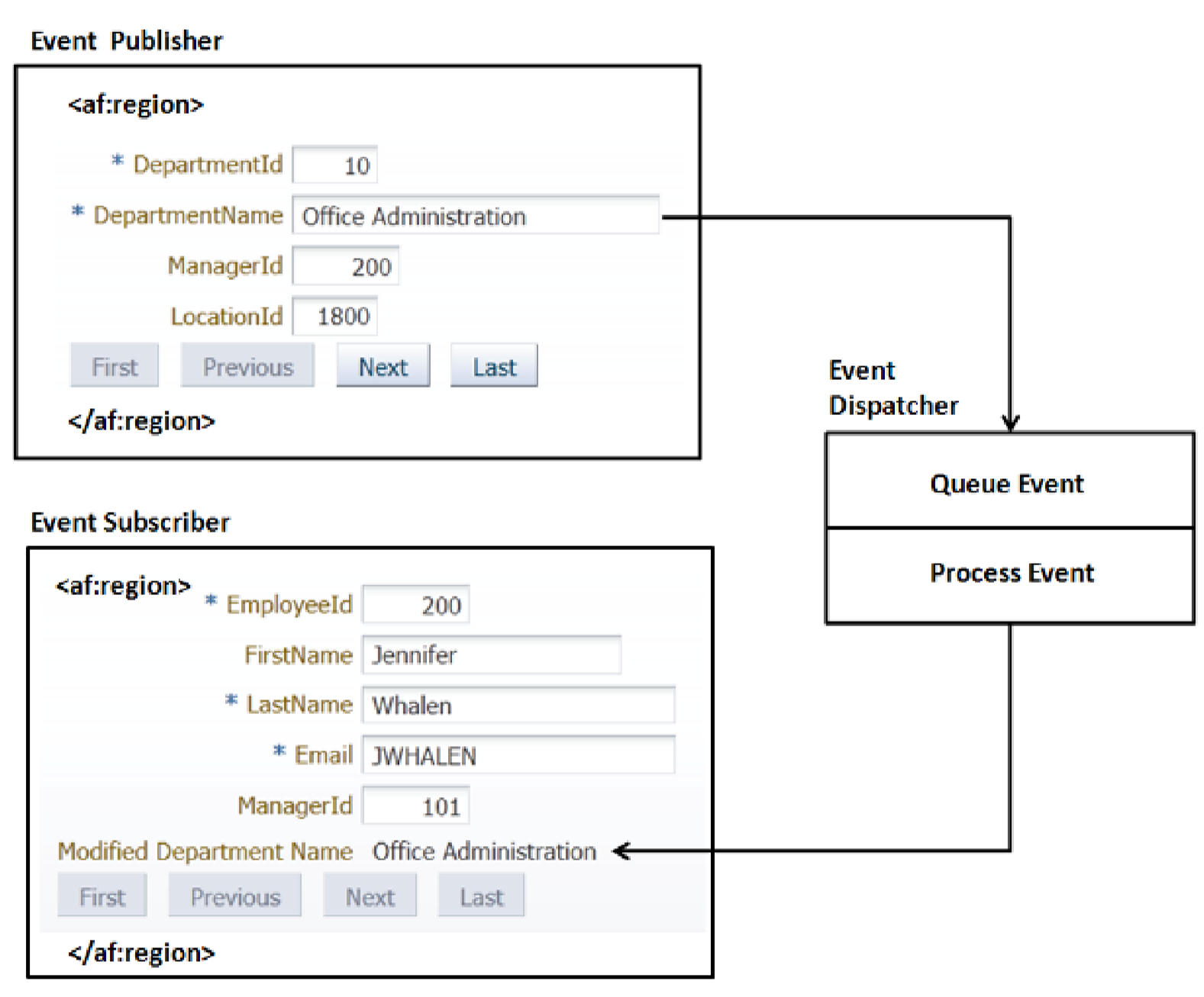
Contextual event model

Slide 19
Using a contextual event
Unlike JSF events, contextual events are very dynamic and flexible in nature. The contextual event model allows you to choose the event types, payload, and event publishers. An event can be subscribed to by multiple interested parties
Defining an event publisher
Defining an event subscriber
Subscribing to desired events

Slide 20
Defining an event publisher
Event Type | Description
Currency Change Event | This event can be published by any tree, table, or list navigator binding in the binding container. The contextual event associated with this event type is fired when the current selection in the underlying data model changes at runtime.
Value Change Event | This event can be published by any attribute binding in the binding container. You may use this event type with any data bound editable component in the UI.
Action Event | This event can be published by any action binding. You may use this event type with any actionable component such as the command button in the UI. The contextual event associated with this event type is fired when the user actions the component at runtime.

Slide 21
Defining an event handler method
Select the Payload tab to specify the custom data that you want to pass as event payload for use by the event subscribers.
Select the Pass Custom Value checkbox and then select the payload data type. Based on the payload type selection, IDE will display various options to select the payload data. Optionally, you can specify raise conditions for the event using a expression in the Raise Condition tab. You can document the event in the Documentation tab.
If you do not specify any payload while defining the contextual event publisher for a value change event on an attribute, then the framework will pass oracle.adf.model.binding.DCBindingContainerValueChangeEvent as a default event payload at runtime.

Slide 22
Defining an event handler method
Create Data Control from Java Bean. right click and choose Create Data Control.
Use the method in a managed bean as an event handler.
<methodAction DataControl="HRServiceAppModuleDataControl" id="DeptNameChangedHandler“
InstanceName="${viewScope.ContextualEventEHandlerBean}"
MethodName="deptNameChanged">
<NamedData NDName="deptName" NDType="java.lang.String"/>
</methodAction>

Slide 23
Defining an event handler method
Remember that if you do not specify any payload while defining a contextual event publisher for the value change event, the framework will implicitly pass an oracle.adf.model.binding.DCBindingContainerValueChangeEvent object as an event payload.
public void implicitPayLoadHandlerMethod(Object payLoadObj) {
DCBindingContainerValueChangeEvent payload = (
DCBindingContainerValueChangeEvent)payLoadObj;
//Read the new value
Object newValue = payload.getNewValue();
//Following line reads the row used in event producer
//Row row= payload.getRow()
}

Slide 24
Contextual event propagation at runtime
When a region triggers a contextual event, it's first propagated to the producer region itself. Then the event is bubbled up to the parent container, up to the root level. Once the event propagation reaches the topmost container, the framework starts dispatching the event to binding containers that have wildcard regions as event producers.
The framework allows you to turn off the event dispatch to regions that have subscribed to all publishers with the producer region set to any (*). The following are the details:
DynamicEventSubscriptions="true"

Slide 25
Dynamically adding multiple regions to a page
ADF allows you to add or remove regions to a page at runtime. This feature is useful if you do not know the number of regions that render in the page at design time
Implementing the logic to return a task flow binding attributes list.
TaskFlowBindingAttributes tfBindingAttrib2 = new TaskFlowBindingAttributes();
tfBindingAttrib2.setId("region2");
tfBindingAttrib2.setTaskFlowId(new TaskFlowId(
"/WEB-INF/multitaskflow/emp-task-flow-definition.xml",
"emp-task-flow-definition"));

Slide 26
Dynamically adding multiple regions to a page
Generating the executable entry for the multitask flow.
<multiTaskFlow id="multiRegion1" taskFlowList="#{pageFlowScope.MultiTaskflowBean.taskFlowBindings}" xmlns="http://xmlns.oracle.com/adf/controller/binding" activation="deferred"/>
Adding regions that refers to multi task flow binding entries in the JSF page.
<af:forEach var="tf“ items="#{bindings.multiRegion1.taskFlowBindingList}">
<af:region value="#{tf.regionModel}" id="reg#{tf.name}"/>
</af:forEach>

Slide 27
Distributing ADF task flow as the ADF library
The ADF Library JAR is a very commonly used mechanism to distribute reusable ADF artefacts such as task flows, page templates, declarative components, and business services within the same application or across different applications. The ADF library follows the Java Archive (JAR) file format with some extra metadata files for use by JDeveloper to manage dependencies

Slide 28
Distributing ADF task flow as the ADF library
The ADF Library JAR is a very commonly used mechanism to distribute reusable ADF artefacts such as task flows, page templates, declarative components, and business services within the same application or across different applications. The ADF library follows the Java Archive (JAR) file format with some extra metadata files for use by JDeveloper to manage dependencies
Packaging the task flow into the ADF library (Create Deployment Descriptor)
Consuming task flows added into an ADF library (Create File System Connection )

Slide 29
Using a train component in a bounded task flow
A typical web application may have some business transactions that span across multiple pages and take a sequential path to complete. Most of the rich enterprise applications provide visual indicators pointing to the current step when the user navigates around different activities in a multi-step process.
ADF Faces provides an af:train component to display a series of stops in a multi-step process.

Slide 30
Creating a train in a bounded task flow
Enabling train support for an existing bounded task flow
Right-click on the task flow and select Train | Create Train in the context menu.
select the Behavior tab and check the Train checkbox
Enter Value as: #{controllerContext.currentRootViewPort.taskFlowContext.trainModel}
Setting display names for train stops
Select View in task flow , In the Property Inspector window, expand the Description section and enter Display Name for the train stop.
For internationalization #{adfBundle['ResourceBundleName'] ['SomeKey']}

Slide 31
Customizing the train stops
Customizing the display for train stops
ADF allows you to customize the train display using the af:navigationPane component. The hint attribute in af:navigationPane decides the display component.
Programmatically navigating between train stops
Apart from using declarative navigation features provided by the train component, you can also use train model APIs to programmatically navigate between train stops.

Slide 32
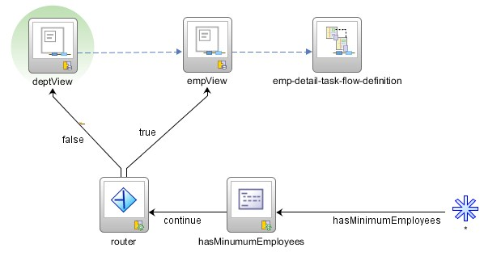
Executing methods while navigating between train stops

Slide 33
Transaction management in a bounded task flow
One of the great advantages of a bounded task flow is its out of the box support for declarative transaction management. Without this support you may end up writing a lot of plumbing code for managing transactions.
The bounded task flow supports the following declarative transaction settings:
No Controller Transaction
Always Begin New Transaction
Always Use Existing Transaction
Use Existing Transaction If Possible
When you mark a data control as shared, the called task flow reuses the same database connection instance and data control instances from the calling task flow.

Slide 34
What happens at runtime?
During the Before Restore View phase of the JSF lifecycle, the framework creates a new root view port for the top level page. During the view port initialization, the framework will build a data control frame to hold data controls and bind containers used in the root view port (parent page).
During the Render Response phase of the JSF lifecycle
If the child task flow is configured to share data control with the calling task flow, then the framework will use the data control frame from the parent page (caller) to serve the child region as well
If the transaction for the task flow is set to Always Begin New Transaction, then the framework will open a new transaction on the data control frame
Always Use Existing Transaction
Use Existing Transaction If Possible
commit and rollback affect on all data controls.

Slide 35
Programmatically managing transactions for a task flow
public void beginTransaction() {
BindingContext context = BindingContext.getCurrent();
//Get the name of Data Control Frame
String dcFrameName = context.getCurrentDataControlFrame();
//GetData control Frame
DataControlFrame dcFrame = context.findDataControlFrame(dcFrameName);
dcFrame.beginTransaction(new TransactionProperties());
}

Slide 36
The life span of a bounded task flow
A bounded task flow becomes eligible for garbage collection in the following scenarios:
When a task flow return activity is executed.
When the region holding a task flow reference switches to a new task flow (by changing the task flow ID).
When the user navigates away from the parent page that contains the task flow.
When a pop up displaying a task flow is dismissed by the user.

